Slide 1
Faster Support
Diane Reynolds

Slide 2
Everyone’s problem
Current Environment:
Support services are under pressure to produce faster resolutions
“the world” is moving faster and demanding answers quickly
Firms are very cost-conscious
Support staff is drowning in data.
Key Question:
How can we use our data resources to reduce support response times?

Slide 3
Methodology
Data: focus is first on support ticket categorization
Step 1: Categorization
Used to “sort” queries – perhaps directing queries to the best qualified support tech available
Step 2: Drill Down
Used to help expert support staff locate interesting, related and relevant articles or (prior) service requests

Slide 4
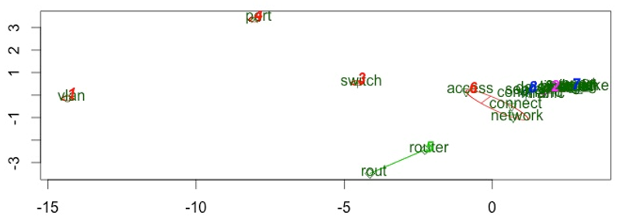
Key Areas

Slide 5
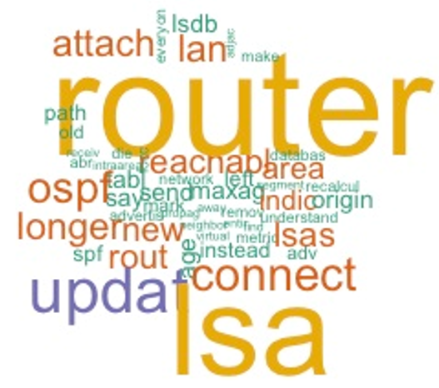
First Drill Down

Slide 6
One and done
Step 1: Categorization
Leverage information known to Cisco including:
Department / Business Group list
Products list
Basic clustering & correlation analysis for related terms
Step 2: Drill down
Subset the data before beginning
Use medium-correlation terms (not just high correlation terms)

